Slide 2
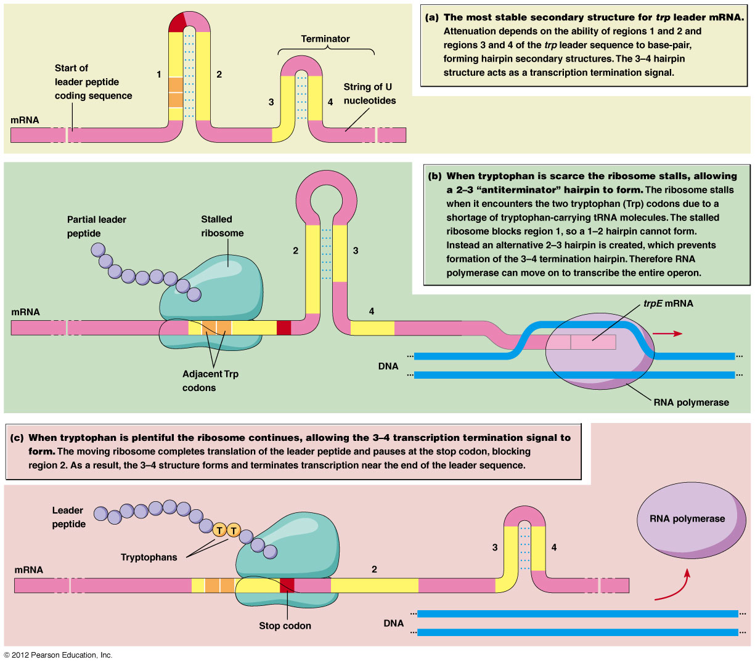

Slide 3
Somewhat low trp levels

Slide 4
Higher Trp levels

Slide 5
Really nice explanations! Spend some time on this really elegant system of gene regulation.
https://www.khanacademy.org/science/biology/gene-regulation/gene-regulation-in-bacteria/a/the-trp-operon
https://www.youtube.com/watch?v=CeE83RyQFRo

Slide 6
Why can’t eukaryotes do this cool thing called attenuation?

Slide 7
And…one more operon
This one should be near and dear to your heart….the Arabinose operon (araBAD)! ---recall the pGLO plasmid is also known as pBAD---why?
Arabinose is a sugar---a carbon/energy source for bacteria. The ara operon encodes enzymes for the breakdown of arabinose.
  Is this catabolism or anabolism?
  Do you expect a repressed, inducible system or a transcribed, repressible system?

Slide 8
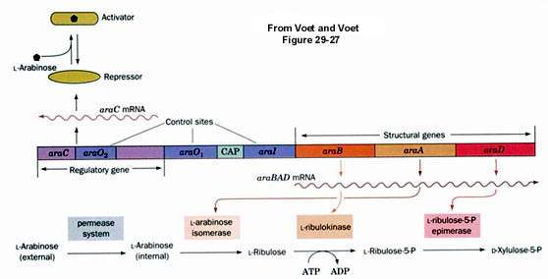
Study the structure

Slide 9
The arabinose operon has yet another, interesting mechanism for controlling transcription of the B, A, and D, genes (needed for arabinose metabolism)
It uses a regulator protein (called AraC), which can act as either a repressor OR an activator, depending on whether the sugar, arabinose binds to it.

Slide 11
AraC bound to arabinose, activates transcription of the araB, araA, araD genes.
Activation requires that catabolite activating protein (CAP). This is the same CAP as we see used in the lac operon regulation.
  Recall what controls whether CAP is present?

Slide 12
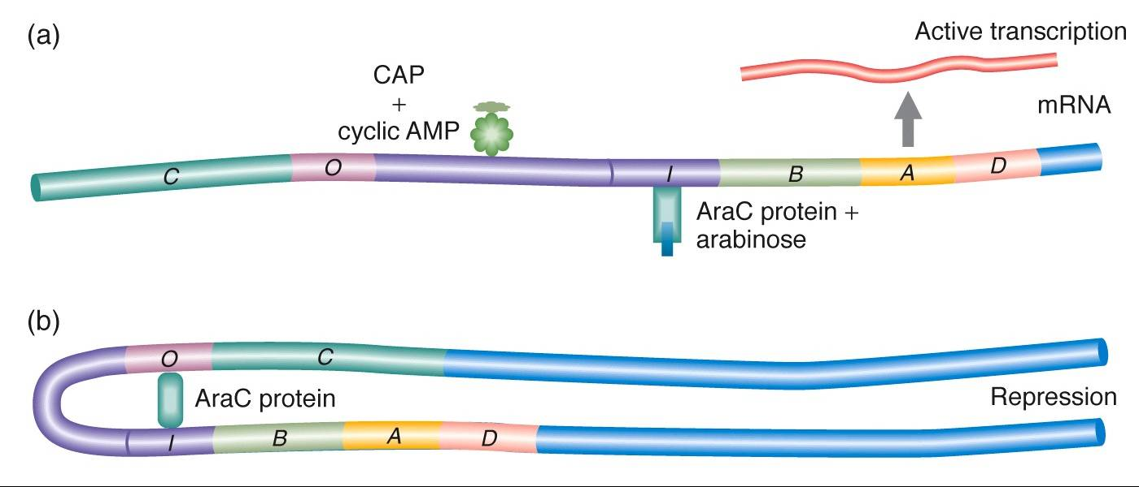
AraC bound to arabinose helps RNApolymerase bind the promoter

Slide 13
In the absence of arabinose, AraC also binds another part of the regulatory region, the operator
AraC interacts with other AraC proteins and causes a looping of the DNA. The looping blocks binding of RNApol to the promoter.
RNAP
see Figure 16-16

Slide 14
We saw a case in which looping of DNA served to enhance transcription in eukaryotes, but the looping did not block RNA polymerase.
This very local looping blocks RNA polymerase.
(So looping is not exclusively activating)

Slide 15
Now we can really understand how pGLO was regulated by arabinose! Molecular biologists can cut DNA (how?) and paste DNA from different sources together. (what do we call these—recombined molecules?)

Slide 16
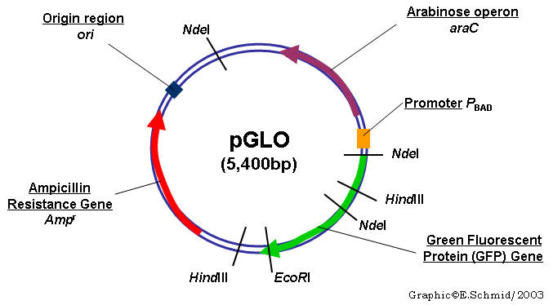

Slide 17
In this way, GFP, was made to be inducible, by arabinose. The E. coli behaved as if they needed to metabolize arabinose, but we got GFP instead of the B,A, and D enzymes!
This is a common way of manipulating expression of a foreign gene in bacteria…VERY COOL…don’t you think?

Slide 18
Test yourself…
Which parts of the pGLO/pBAD plasmid are cis elements of gene regulation?
Which genes show constitutive transcription?
Which are regulated?

